Slide 1
Chapter 9
One-Sample t-Test

Slide 2
Learning Objectives
Explain the concept of one-sample t-test
Describe the main assumptions and design considerations of one-sample t-test
Describe the statistical significance
Formulate research problem and frame hypothesis
Explain the decision for assigning a test value for one-sample t-test

Slide 3
Describe the concept of one- and two-tailed conditions
Demonstrate the steps used in SPSS to execute one-sample t-test.
Explain how to analyse and interpret SPSS outputs of one-sample t-test
Describe the formulae and calculations of one sample t-test
Report the results of one-sample t-test

Slide 4
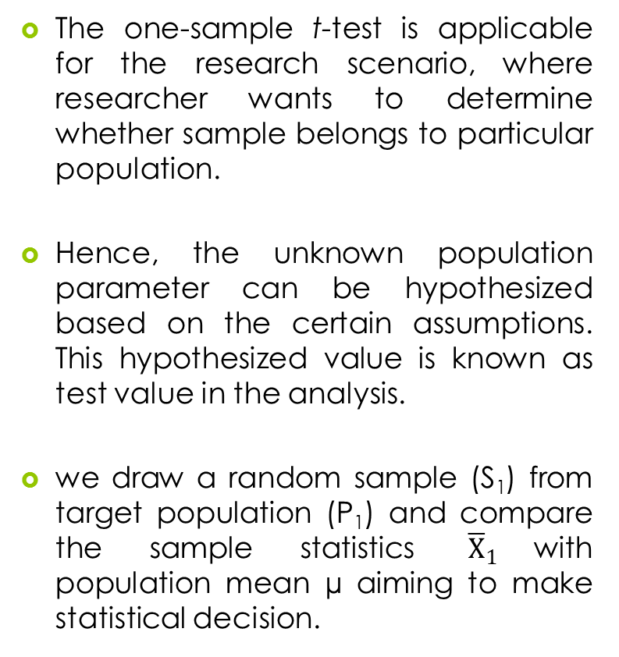
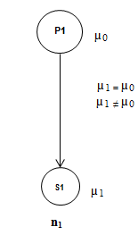
Introduction

Slide 5
Assumptions and Design Consideration for One-Sample t-Test
Normal distributed dependent variable: The dependent variable should be normal distributed in target population.
Designing experiment: The sample should be drawn randomly from the target population.
Data scale: The measurement scale of dependent variable(s) is an important criterion for validity of results.
Population parameter: The assumption about the unknown population parameter affects the results of one-sample t-test.

Slide 6
Summary of Assumptions
Table 9.1. Assumptions for One-Sample t-Test
Assumptions | Examine approach | Measures/Tests
Normal distribution | Graphical method | Histogram and box and whisker plot
 | Numerical method | Skewness and kurtosis
 |  | KS one sample and Shapiro–Wilk
Random sample | Methodological | –
Independent observation | Methodological | –
Data scale | Methodological | Interval or ratio scales of measurement
Population parameter | Methodological | Hypothesized value

Slide 7
Framing Hypothesis and Statistical Significance
Hypothesis for Two-tailed Test: In these cases, null hypothesis expresses the condition of equality for population mean (µ₁) and hypothesized value (µ₀).
Null hypothesis H₀: µ₁ = µ₀
(Population means and hypothesized value are equal.)
Alternative hypothesis H_{a}: µ₁ ≠ µ₀
(Population means and hypothesized value are not equal.)

Slide 8
Hypothesis for One-tailed Test: One-tailed hypothesis is used to determine whether the population mean differs from the hypothesized value in a direction of interest (either positive or negative).
Null hypothesis H₀: µ₁ = µ₀
(Population means and hypothesized value are equal.)
Alternative hypothesis H_{a1}: µ₁ > µ₀
(Population mean is greater than the hypothesized value.)
H_{a2}: µ₁ < µ₀
(Population mean is lower than the hypothesized value.)

Slide 9
Decision on Assigning the Test Value
The test value is decided as per the criteria of null hypothesis. The test value is considered as a hypothesized value and used to compare with sample statistic (Steven 2008).
This test value indicates a specific value about ‘test variable’ and is based on the continuous scale (either interval or ratio).

Slide 10
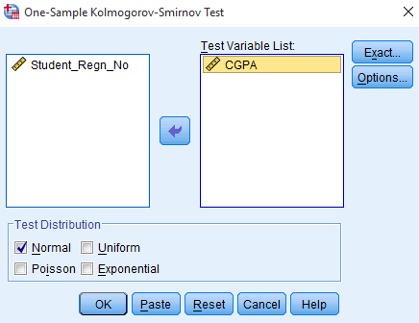
Executing One-Sample t-Test with SPSS Procedure
Assessing Normality
Exhibit 9.1. Use graduate.sav » Menu bar » analyse » Non-parametric test » Legacy Dialogs » One sample KS test » CGPA transfer to Test Variable(s) List » Click on Normal distribution under Test Distribution » OK

Slide 11
Result of Assumption
Table 9.2. Assessing Normality with One-Sample KS
 | N | Normal Parameters |  | K-S Z | Sig. (2-tailed)
 |  | Mean | Std. Deviation
CGPA | 90 | 6.16 | 1.79 | 0.09 | 0.065
The p-value is more than 0.05 (p > 0.05, 0.065 at 5% LoS); hence, we fail to reject the null hypothesis indicating the condition of normality. Thus, we conclude that CGPA is normal distributed and can be used for t-test analysis.

Slide 12
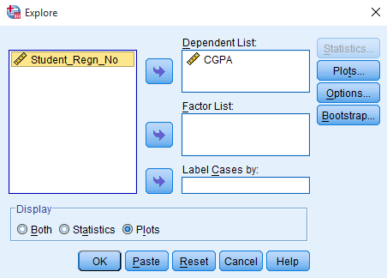
Examine Assumption Graphically
Exhibit 9.2. Use graduate.sav » Menu bar » analyse » Descriptive statistics » Explore » Select CGPA and transfer into Dependent List box » Select Plots under Display box » Plots » Continue » Click OK

Slide 13
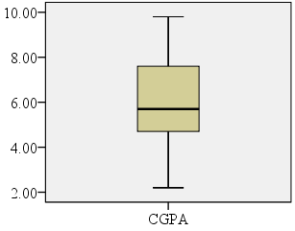
Fairly symmetric distribution of CGPA and indicates the assumption of normality in data.

Slide 14
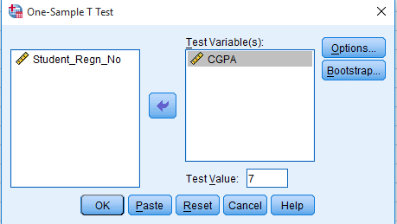
SPSS Path for Descriptive Statistics and Measures of t-Test
Exhibit 9.3. Use graduate.sav » Menu bar » analyse » Compare means » One-sample t-test » Select » CGPA transfer to Test Variable(s) » Type 7.0 in Test Value » Click OK

Slide 15
Interpreting Outputs of One-Sample t-Test
Descriptive Statistics
Table 9.3. Descriptive Statistics: One-Sample t-Test
 | N | Mean | Std. Deviation | Std. Error Mean
CGPA | 90 | 6.16 | 1.79 | 0.188

Slide 16
One-Sample t-Test Statistics
Null hypothesis H₀: µ₁= µ₀
(Population CGPA mean is equal to 7.0.)
Alternative hypothesis H_{a}: µ₁ ≠ µ₀
(Population CGPA mean is not equal to 7.0.)

Slide 17
Results
Table 9.4. One-Sample Test Statistics
 | Test Value = 7.0
 | T | df | Sig. (2-tailed) | Mean Difference | 95% Confidence Interval of the Difference
 |  |  |  |  | Lower | Upper
CGPA | −4.4 | 89 | 0.000 | −0.83 | −1.20 | −0.45

Slide 18
One-sample t-test statistics indicate that the mean CGPA for graduate students is significantly less as compared to the preset value due to lower p-value (p < 0.05, p = 0.000) at 5% LoS.
Thus, sufficient evidence favours in rejecting the null hypothesis and conclude that a significant difference exists between observed mean and the hypothesized value.

Slide 19
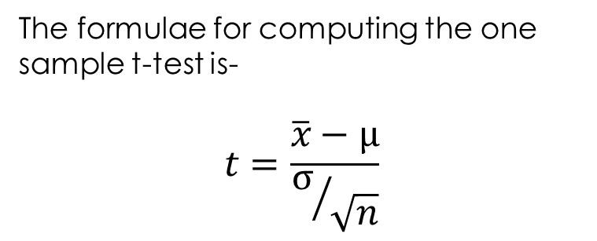
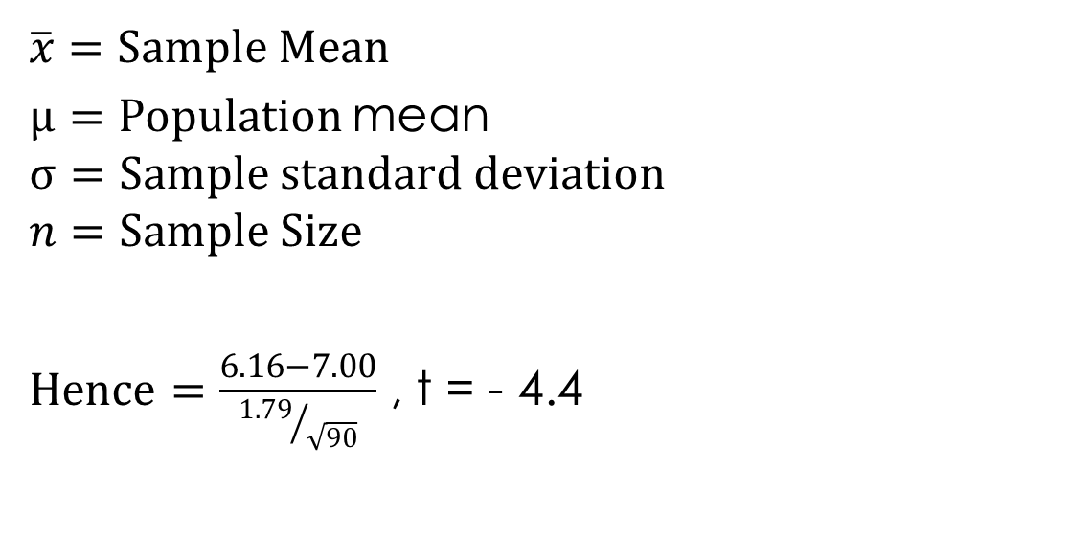

Slide 20
One-Sample t-Test (One-tailed)
Null hypothesis H₀: µ₁ = 7.0
(Population CGPA mean is equal to 7.0.)
Alternative hypothesis H_{a}: µ₁ < 7.0
(Population CGPA mean is lower than 7.0.)

Slide 21
In one-tailed condition, Sig. (2-tailed) value as computed by SPSS will be divided by 2 and the modified p-value will be used for the decision-making.
In our case, as the p-value is less than 0.05 (α level) after dividing by 2, we reject the null hypothesis and conclude that the population CGPA is less than the hypothesized value.

Slide 22
Reporting the Final Results of One-Sample t-Test
The p-values associated with one-sample KS test (KS Z = 1.03, p < 0.05, 0.065) is more than 5 per cent LoS; hence, we fail to reject the null hypothesis of normal distributed population.
The p-value associated with one sample t-test statistics [t (89) = −4.4, p < 0.05, 0.000)] is less than the criterion value (5% LoS); hence, we reject the null hypothesis of equal means between population parameter and hypothesized value.

Slide 23
Key Terms
95% confidence interval of mean Dependent variable Hypothesized value Mean difference Normally distributed population One-Sample t-testx | Population parameter Pre-set value Random sample Test value Two tailed and One-tailed condition

